Slide 1
Hate Speech Detection based on Sentiment Knowledge Sharing
2021.11.01 • ChongQing
——ACL2021
Reported by Changjiang Hu

Slide 2
Introduction
With the prevalence of mobile Internet and social media, phenomena such as the malicious spread of hate speech have gradually become widespread. This often has incalculable consequences and has become a serious social problem.
How to quickly and accurately detect hate speech automatically,and then better intervene to prevent it has become one of the hot research issues in the field of natural language processing.
The deep learning methods of predecessors often only used pre-trained models or deeper networks to obtain semantic features, ignoring the sentiment features of the target sentences and external sentiment resources, which also makes the performance of neural networks unsatisfactory in hate speech detection.

Slide 3
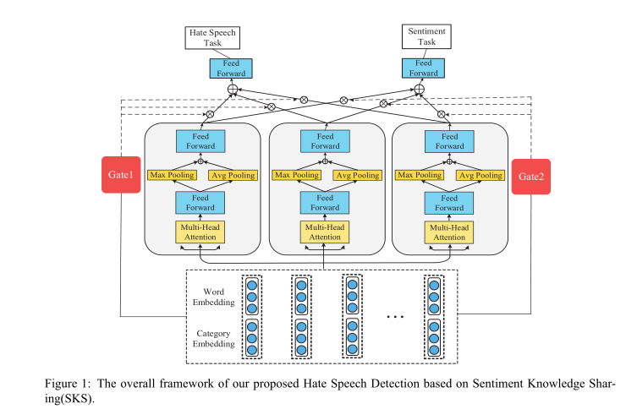
Method

Slide 4
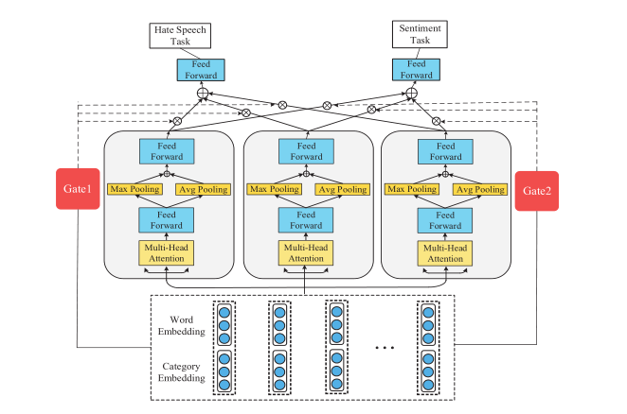
Method
Input Layer
1.Hate Speech
2.Disability
3.LGBT
4.Ethnic
5.Religious

Slide 5
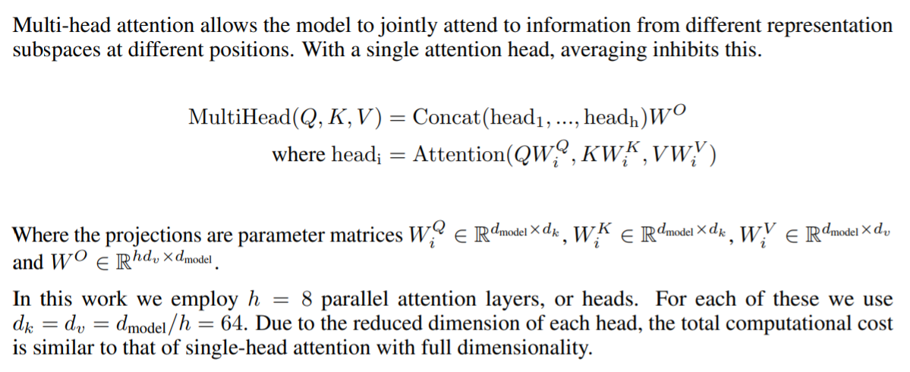
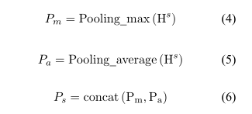
Method

Slide 6
Method
Gated attention can learn to select a subset of the feature extraction units to use, conditioned on the input .For different tasks, the weight selection of the model is different, so each task has a Gate. The output of a specific gate k represents the probability of a different feature extract unit being selected, and multiple units are weighted and summed to obtain the final representation of the sentence, which will be passed into the exclusive layer of the task. Our gating unit has the same structure as the feature extraction unit. The formula is as follows:
where k is the number of tasks and h is the hidden layer representation

Slide 7
Method

Slide 8
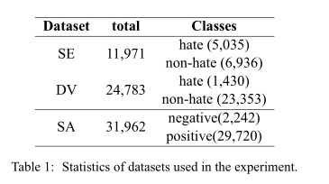
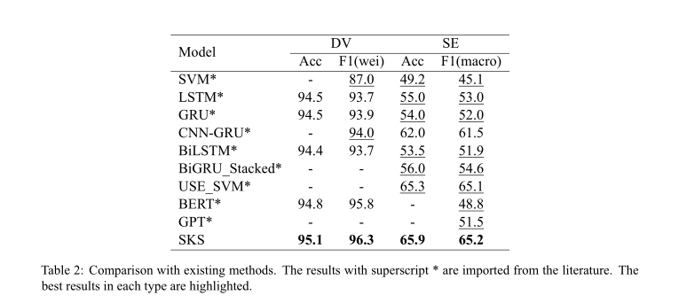
Experiment

Slide 9
Experiments

Slide 10
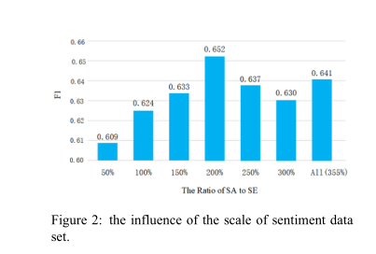
Experiments

Slide 11
Thanks

